Slide 1

ithmetic Optical Character Recognition Calculator and Translator
OCR
Notes:
Good evening everyone! Thank you for still being here ☺

Slide 2
Table of contents
01
02
03
04
Introduction
Calculator - I
Calculator and Translator
CNN designed to recognize handwritten digits and arithmetic operators
Calculator - II
Letters & Translation
Use of pre-trained models for handwritten character recognition. Demo
CNN designed to recognize handwritten characters and perform translation
05
06
Future Work
Discussion
Proposition of possible next iterations of this project
Notes:
For our presentation today, we are going to provide you a bried introduction to our project, talk about both approaches used for the calculations and the approach used for text recognition. And leave a bit of time in the end to discuss future work propositions and QA

Slide 3
01
Introduction

Slide 4
OCR?
What? Why?
Transforms text into a machine-readable format
Search
Edit
Efficiency and productivity
Preservation
Optical Character Recognition
Processing and analysis of visual data – images containing text
Notes:
What is OCR?
It stands for Optical Character Recognition
and involves the processing and analysis of visual data, generally images containing text.
The goal of OCR is to transform text into a machine-readable format , which then allow us as users to search, edit
But it can also impact greatly efficiency and productivity since it automates data entry and document processing when compared to manual methods

Slide 5
Calculator
Translator
WHY build an OCR Calculator?
Bridge the gap between physical and digital mathematics.
Educational support
WHY build an OCR Translator?
Digitization of handwritten documents
Enhanced searchability
Language translation
Notes:
Wanting to explore the capabilities of Optical Character Recognition, we set ourselves to build a calculator and a translator, to leverage both digits and letters.
Why build an OCR calculator:
It allows users to seamlessly convert handwritten or printed mathematical expressions into digital, computable formats 2) for instance, it can serve as a powerful educational aid, helping students check their work and practice problem-solving in a more interactive way
Why build an OCR translator: There are many benefits that come from building an OCR Translator, such as
allows for the conversion of handwritten text into digital, machine-readable formats, which opens the door to ...
Digitized text from handwritten documents becomes searchable, making it easier to find specific information within large collections of documents. And focused on our use case,

Slide 6
Our Approach
CNN
Pre-Existing Solutions
Tesseract
Calculator
EasyOCR
Translator
PaddleOCR
TrOCR
Notes:
So, to leverage both digit and letter identification, we used Convolutional Neural Networks which Nicolas and Dima are going to further explain in a moment.
But we also analyzed pre-existing solutions available
to compare our CNN results. There are multiple solutions available, each with its strengths in different tasks,
Of the tools available, we looked into these four that I will also explain in more detail.
Now, Nicolas will explain his approach.

Slide 7
02
Calculator - I

Slide 8
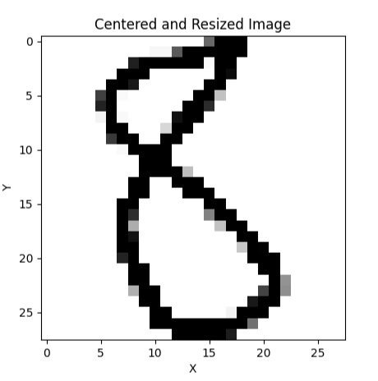
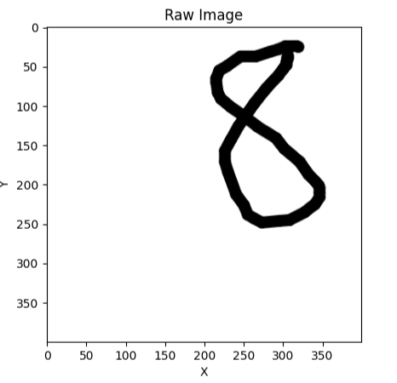
Dataset
Classes = 0,1,2,3,4,5,6,7,8,9,+,-,*,/,=,x

Slide 9
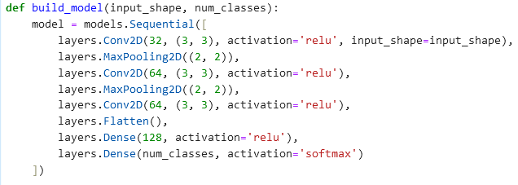
CNN - Definition
500 pictures per class
Training/test split
10 epochs

Slide 10
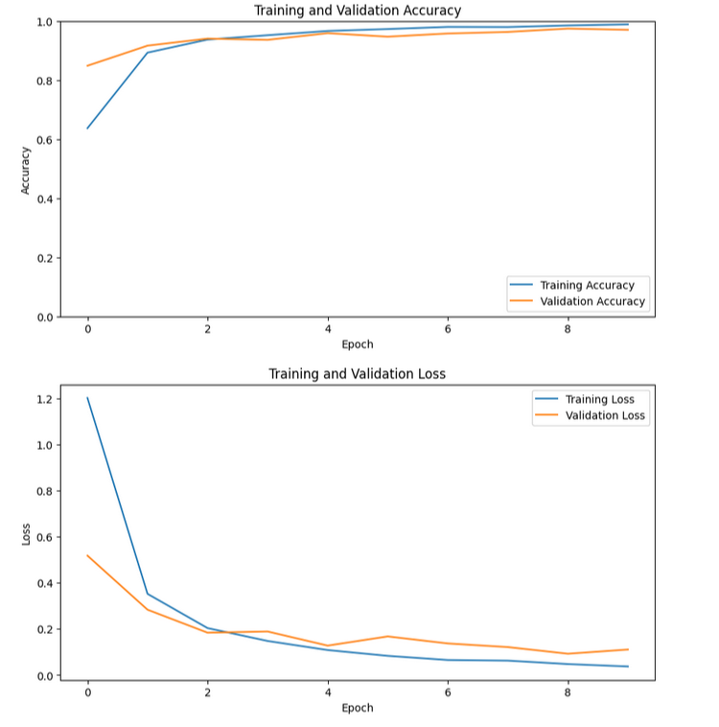
CNN Quality

Slide 11
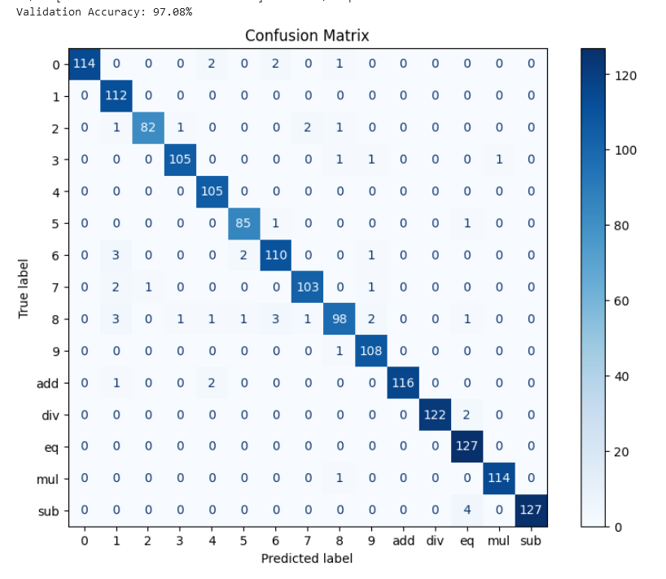
Confusion Matrix

Slide 12
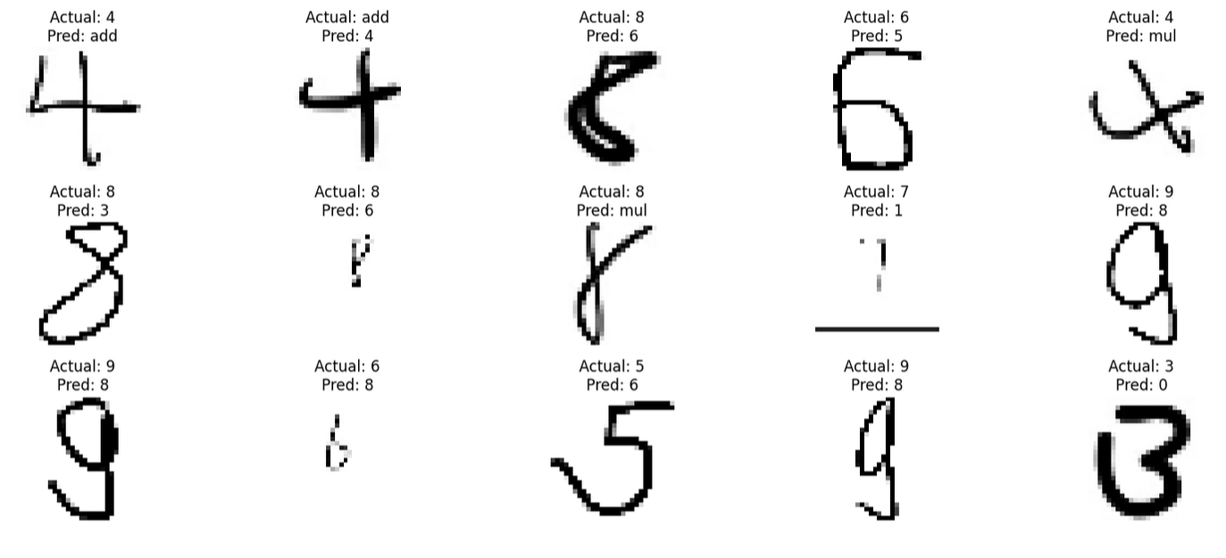
Missclassification

Slide 13
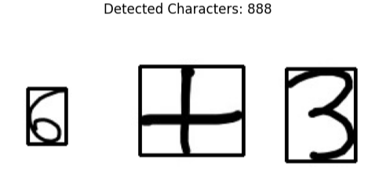
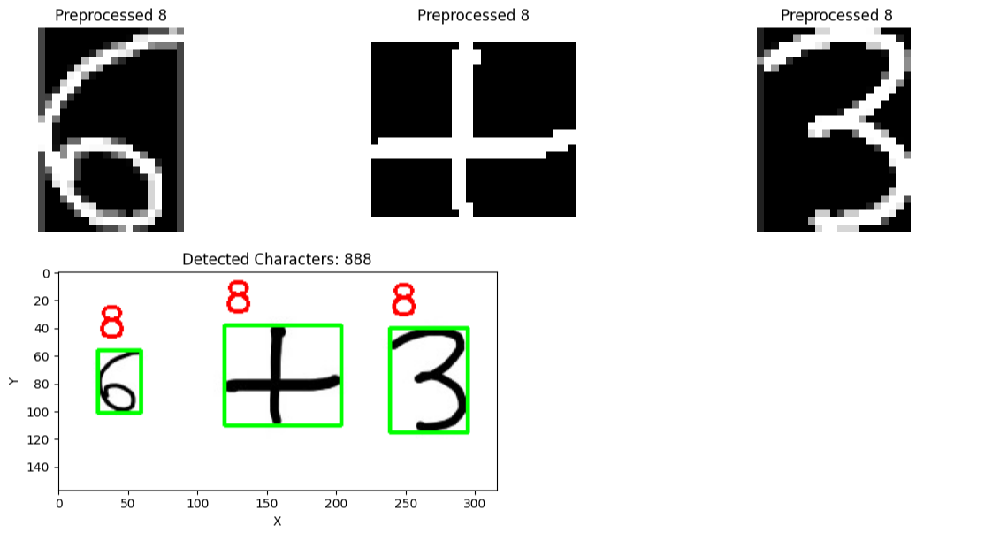
Object detection

Slide 14
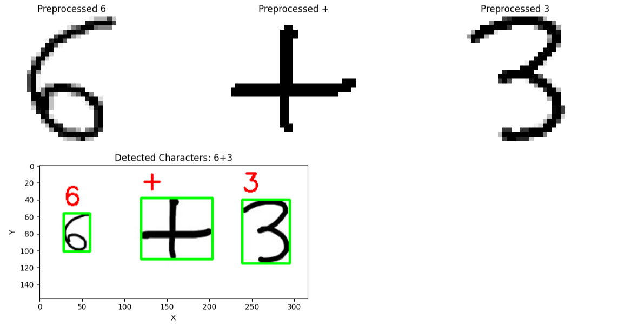
Object Detection Improvement

Slide 15
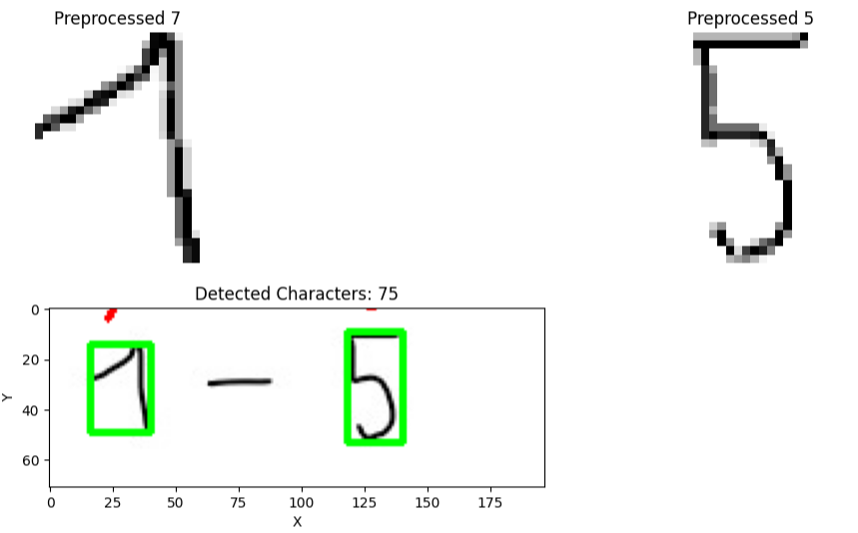
Detection Error

Slide 16
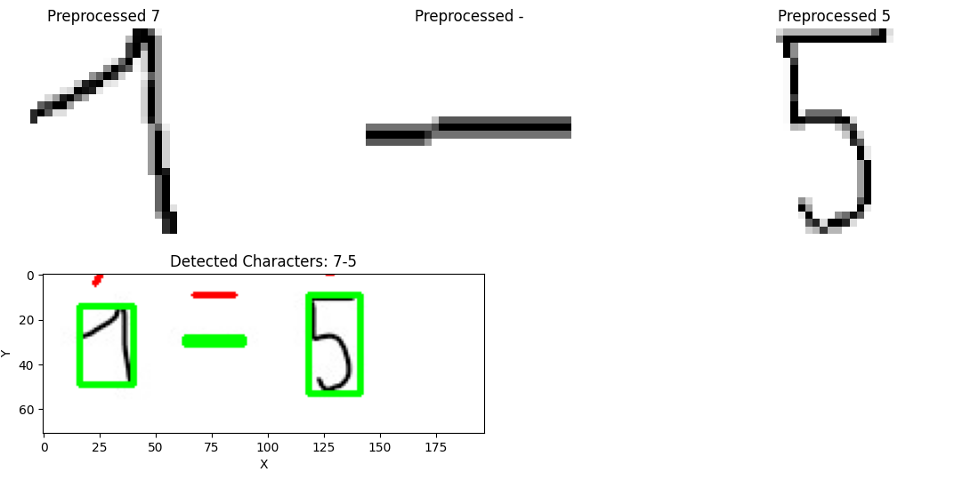
Object Detection Improvment

Slide 17
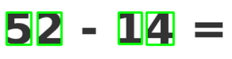
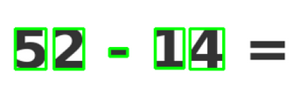
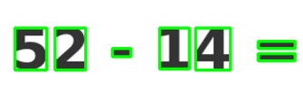
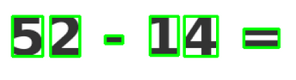
Object Detection Improvment
The Detection has to be improved step by step

Slide 18
03
Calculator - II
Notes:
We wanted to go further and explore the potencial of OCR.
There are so many use cases for Optical Character Recognition that this is evolving more and more, and expanding its capabilities.

Slide 19

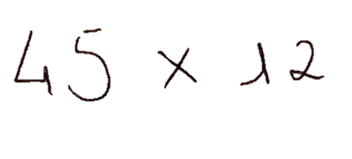


Steps
=
45 x 12
Image Loading
Image Preprocessing
Text Extraction
Contour Detection
Evaluate Expression
Notes:
For all the solutions we analyzed, the workflow was kept similar.
After initializing the OCR, the image is loaded and then preprocessed. Preprocessing usually consists of converting to grayscale, binarization and denoising.
Then the text is extracted from the image. For extraction, some solutions benefited from a whitelist which narrows down the characters for the OCR to look for. This obviously limits the complexity of the mathematical expressions that this can handle, but improved accuracy for the task.
We also output the bounding countours of each character for analysis
The last step consists of returning the result of the handwritten expression based on the digits and operators extracted.

Slide 20



PaddleOCR
Tesseract
CER* : 19%
CER* : 38%
EasyOCR
TrOCR
TrOCR
CER*: 12%
CER *: 15%
* CER – Character Error Rate
Calculated for each solution, on 100 images
Notes:
As I mentioned before, we looked into multiple of the existing solutions. I say solutions specifically because some are not models per se, like PaddleOCR which is a toolkit that makes use of deep learning models to achieve fast and accurate results.
Tesseract is an open source engine created by HP in the 80’s and maintained by Google that uses Long Short-Term Memory neural networks in its latest versions for improved accuracy. It was used via PyTesseract is a Python wrapper that facilitates working with Tesseract within Python environments.
EasyOCR which is a package for OCR tasks. We looked into it initially to then compare the results in the rest of the tested options. I mention it because it is a very user friendly solution for OCR tasks that showed good results and is quite fast.
Lastly, TrOCR which is where we focused our efforts.

Slide 21
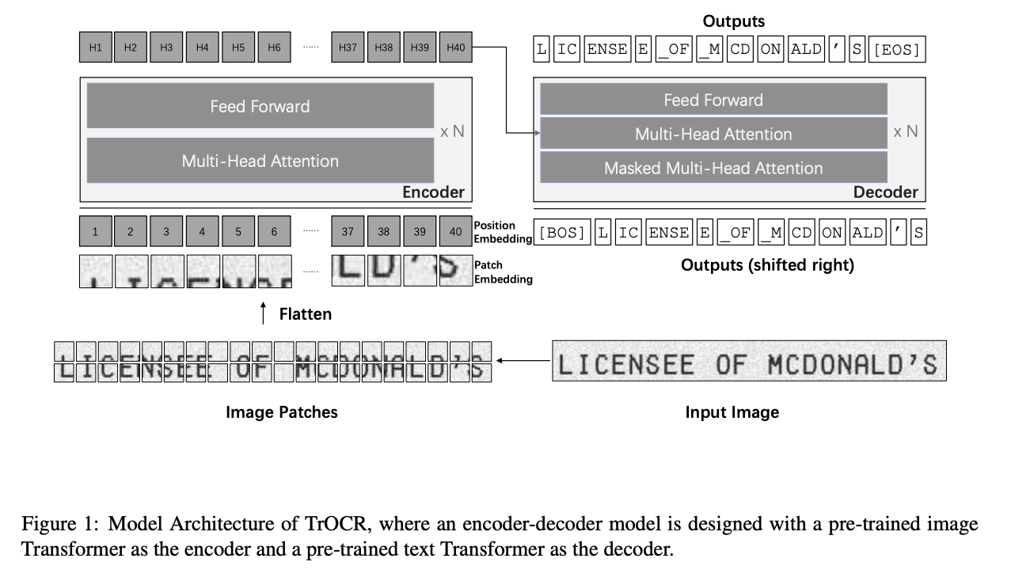
TrOCR
TrOCR
Transformer-based Optical Character Recognition
Li, Minghao, et al. 2023.
Notes:
Without going too much into detail,
TrOCR consists of two main components:
An image Transformer encoder
The input image is resized, then split into 16x16 pixel patches. These patches are fed into the image transformer encoder and the encoder is normally initialized with a pre-trained vision transformer (BEiT)
The output of the encoder is passed to the text Transformer decoder
Which is ypically initialized with a pre-trained language model like RoBERTa
The decoder generates wordpiece-level text based on the visual features that the encoder extracted

Slide 22
TrOCR
TrOCR
Transformer-based Optical Character Recognition
Pre-Trained
(stage 1)
Handwritten
Printed
Scene
Small
Small
Small
Small
Base
Base
Base
Base
Large
Large
Large
Notes:
Pre-trained models are trained on large-scale synthetic data and can be further fine-tuned for specific tasks or datasets.
The others are fine-tuned for specific tasks.
- Handwritten is fine-tuned on IAM dataset
- Printed is fine-tuned on SROIE datasets (digitized receipts)
And Scene, wich is for scene text recognition, is identifying and localizing text within images of videos.
Most of them have three version, with large version being the best performing but also the most computationaly expensive, and the smallest being faster but less accurate.

Slide 23
TrOCR
TrOCR
Transformer-based Optical Character Recognition
Pre-Trained
(stage 1)
Handwritten
Printed
Scene
Small
Small
Small
Small
Base
Base
Base
Base
Large
Large
Large
Notes:
Since we’re handling handwritten text, it would be predictable that this stands out from the other for this task.
But after testing all three versions of the handwritten model, which like I said, is fine-tuned on a very common dataset, the IAM dataset, and further fine-tuning its base version with mathwriting dataset, the model that actually performed best was

Slide 24
TrOCR
TrOCR
Transformer-based Optical Character Recognition
Pre-Trained
(stage 1)
Handwritten
Printed
Scene
Small
Small
Small
Small
Base
Base
Base
Base
Large
Large
Large
Notes:
The base version of the stage1 model, with the lowest CER.

Slide 25
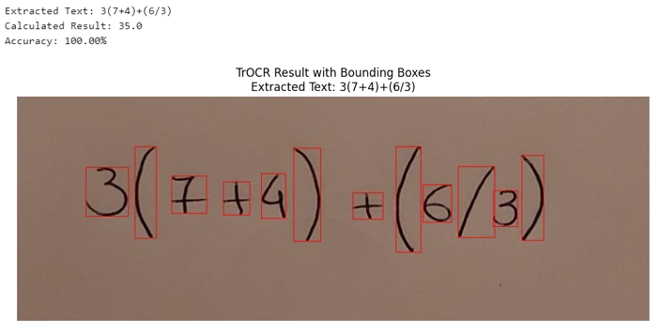
Notes:
This is a small example of TrOCR in action. An image with a mathematical expression was provided that contained parenthesis, implied multiplication. It returns the text that the model detected, the result of that expression and the accuracy in extracting the text, compared to the ground truth

Slide 26
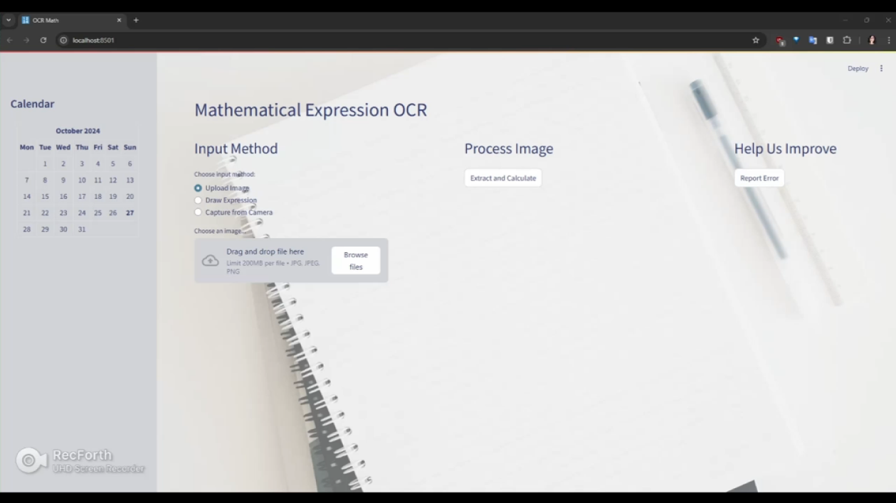
Demo

Slide 27
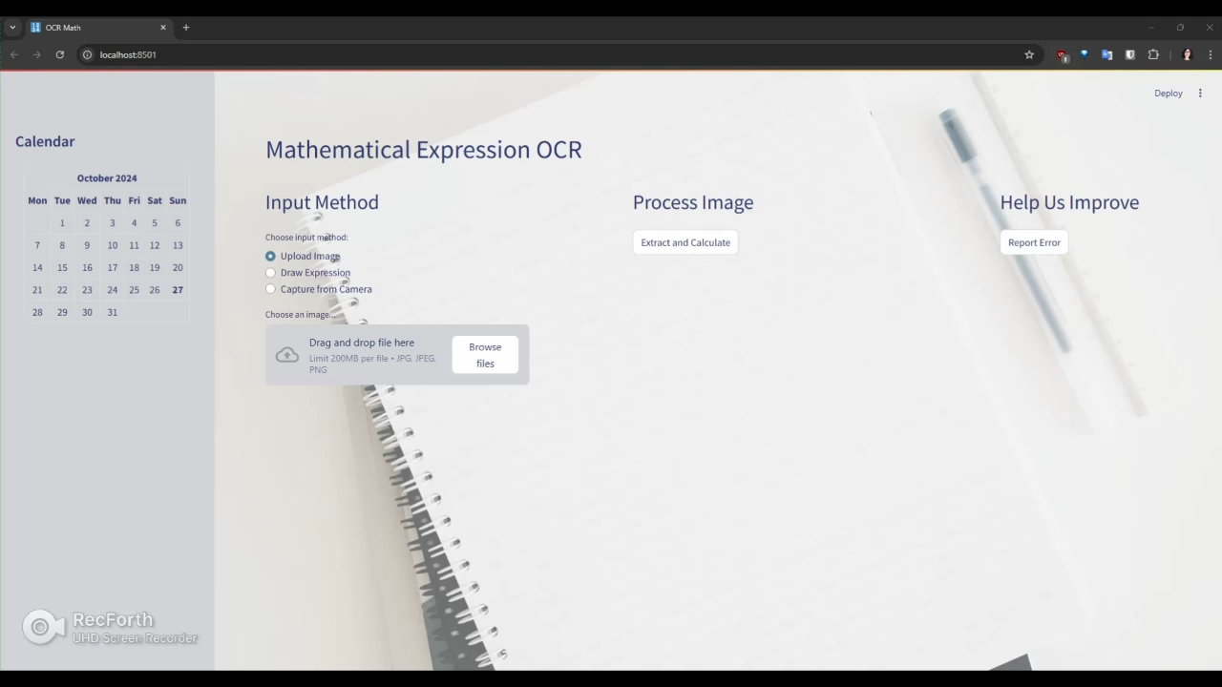

Slide 28
Letters
04

Slide 29
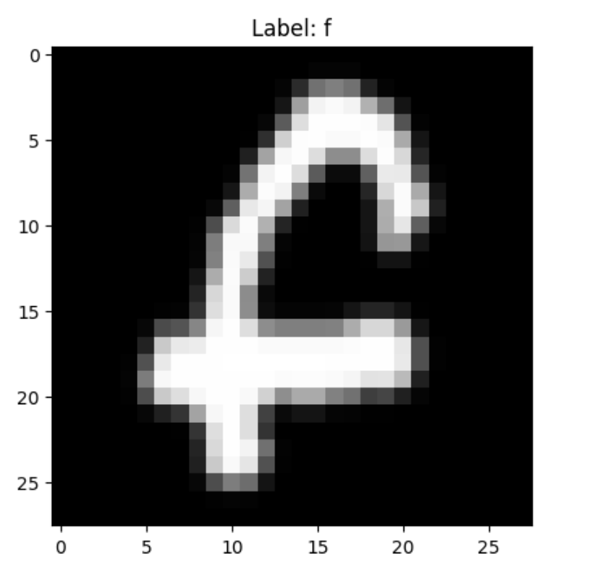
Dataset 1: Upper and Lower Case together in 26 classes
The EMNIST Letters dataset merges a balanced set of the uppercase and lowercase letters into a single 26-class task.
train: 88,800 test: 14,800 total: 103,600 classes: 37

Slide 30
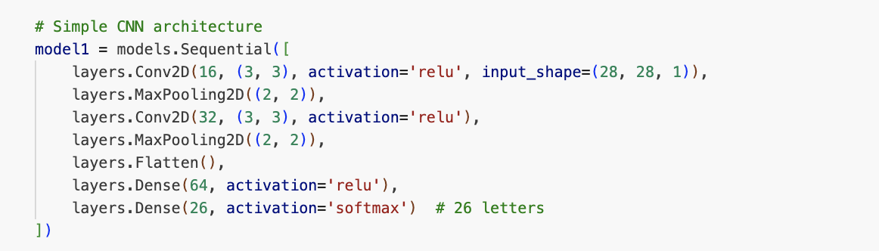
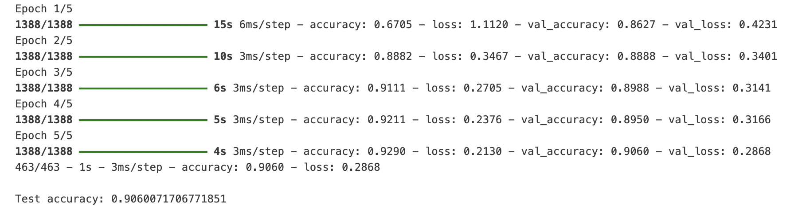
Simple architecture

Slide 31
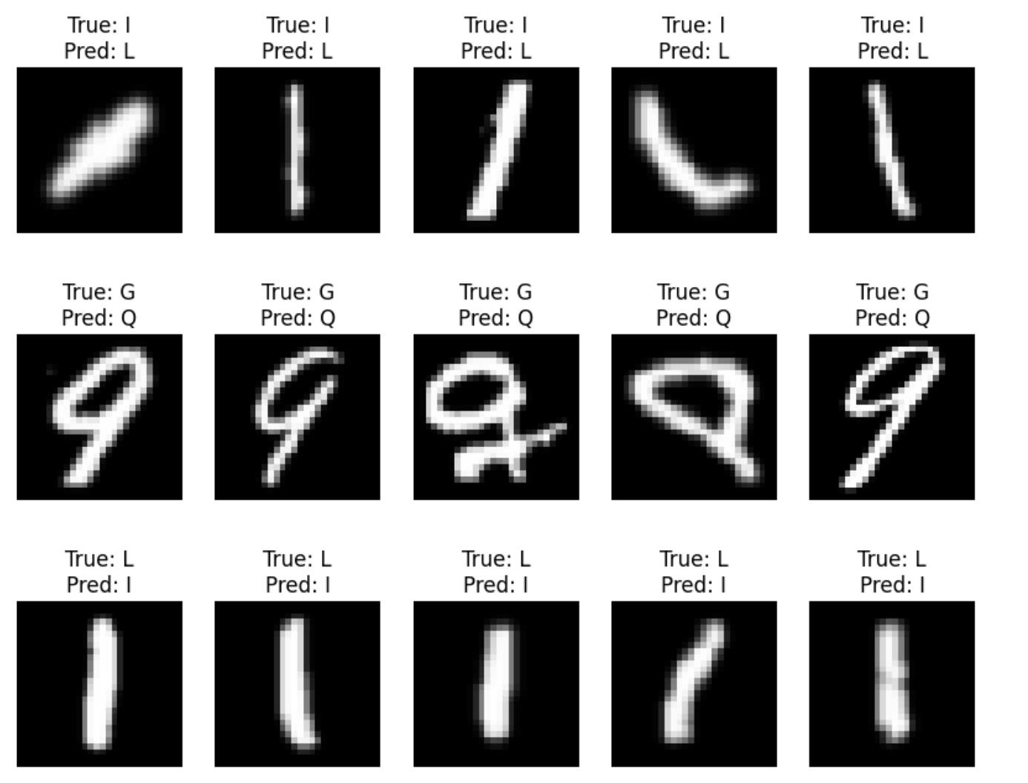
Misclassification

Slide 32
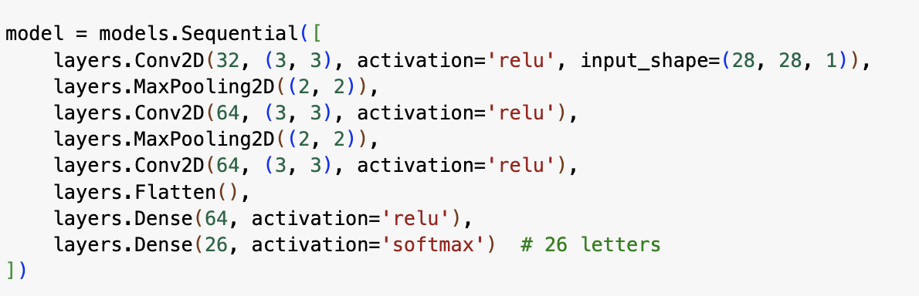
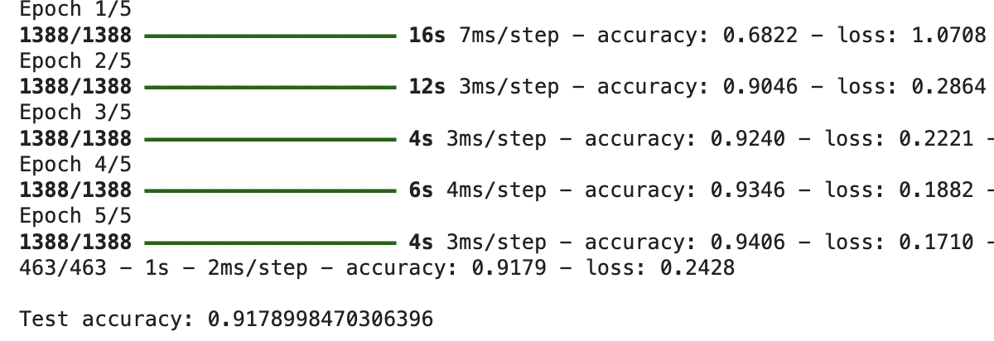
A bit more complex architecture
92% — slightly better

Slide 33
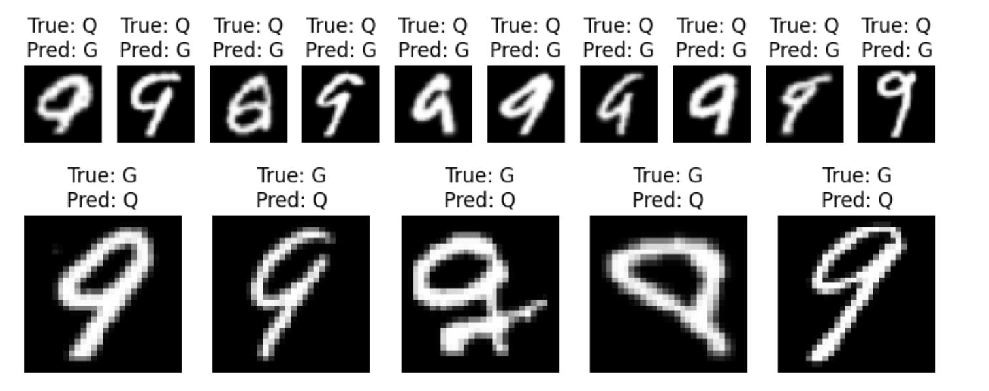
Misclassification

Slide 34
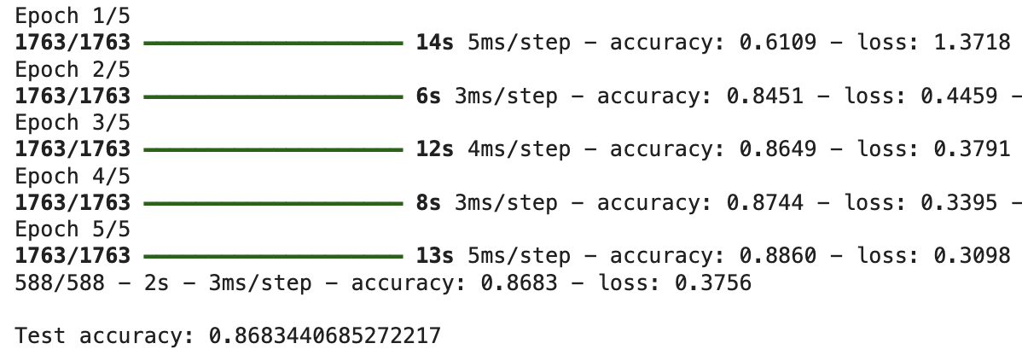
Separate labels for Upper & lower case
86% accuracy — why?

Slide 35
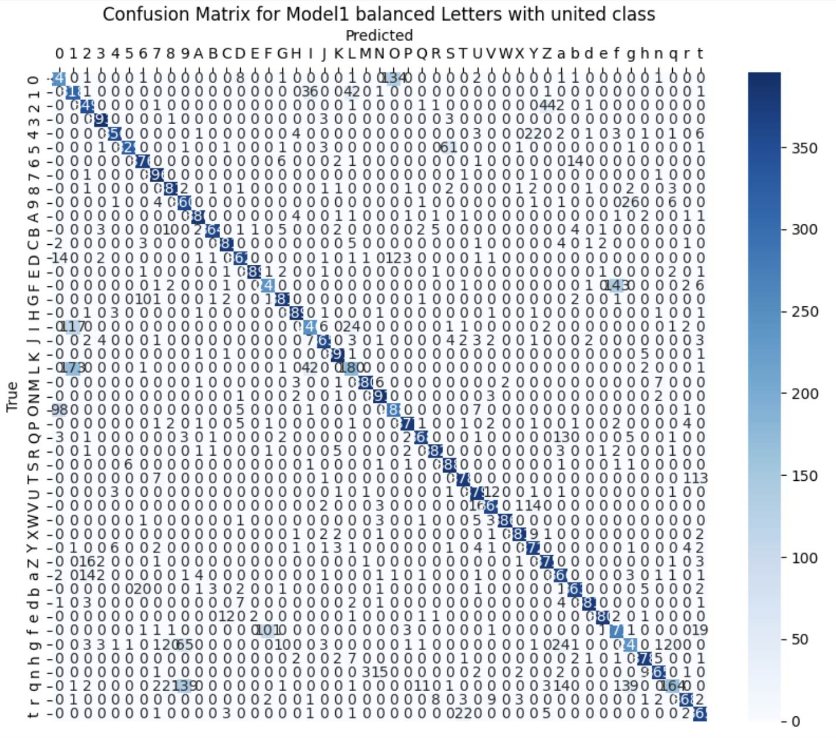
Confusion Matrix letters + digits

Slide 36
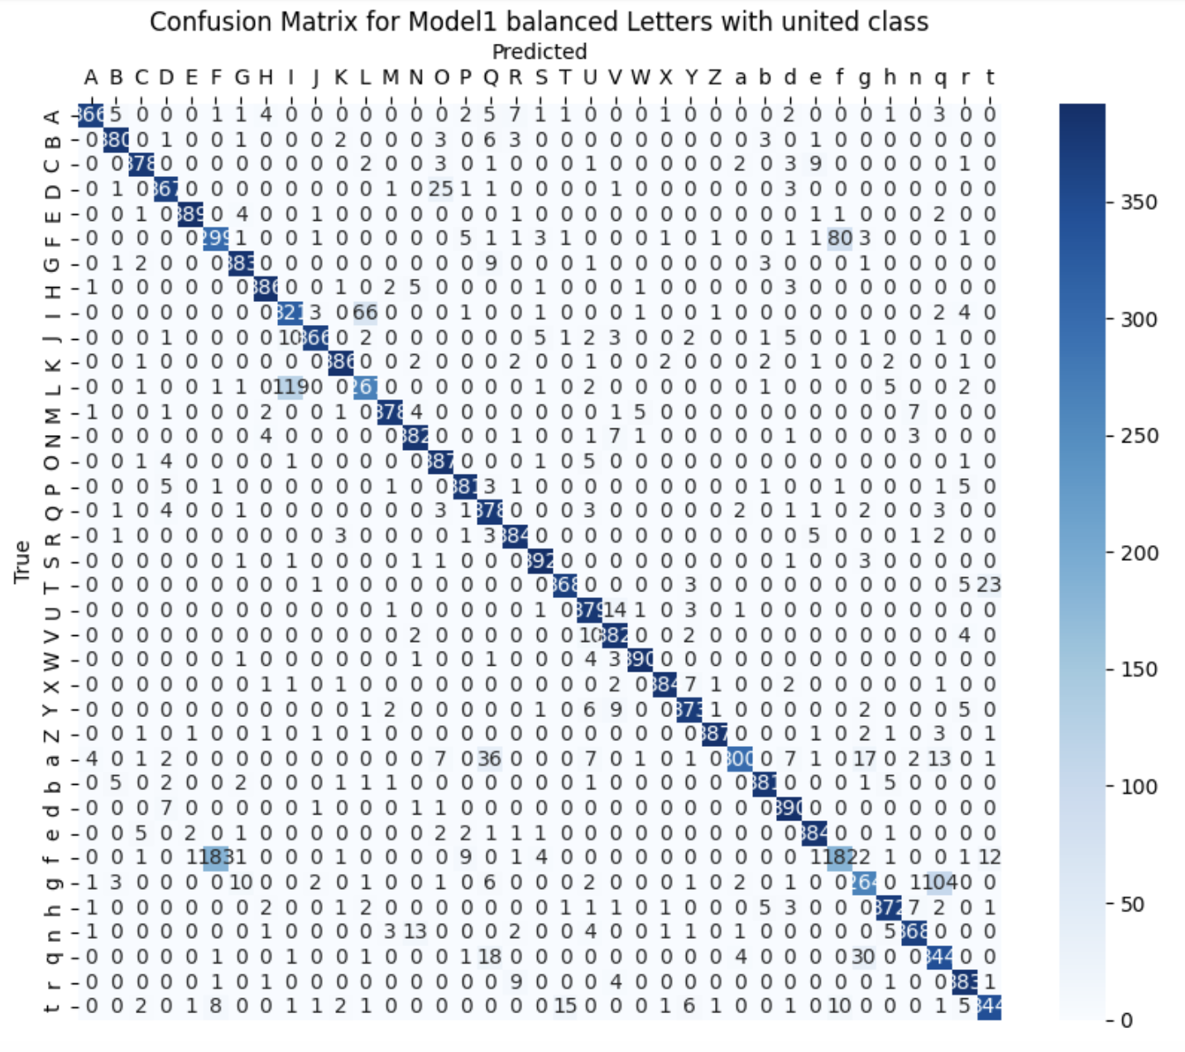
Confusion Matrix letters Accuracy — 90%

Slide 37
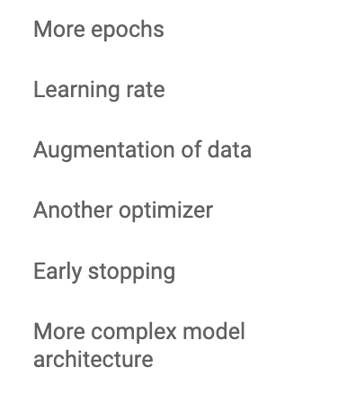
Improvements

Slide 38
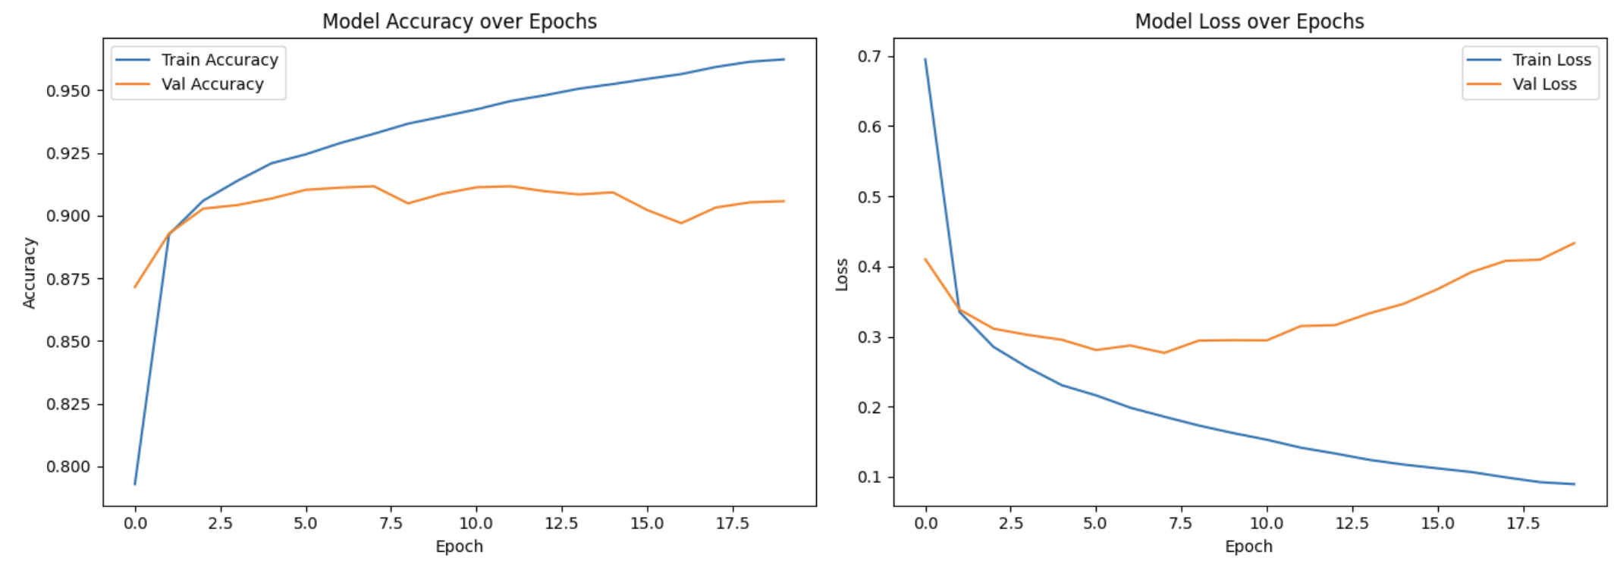
More epochs

Slide 39
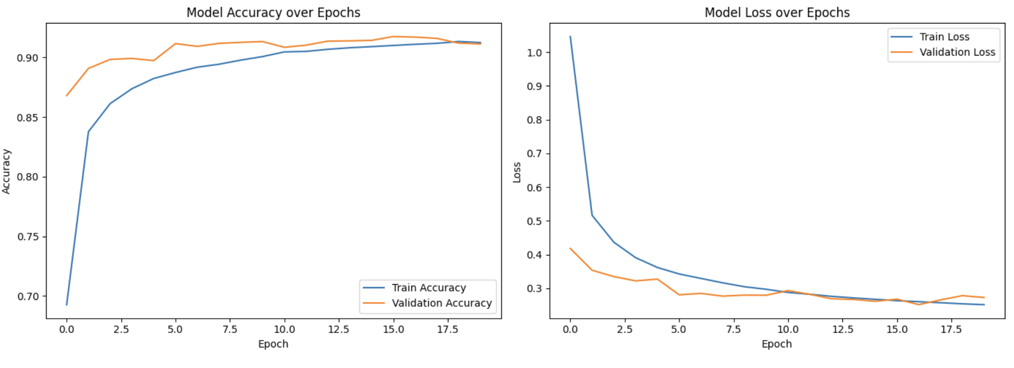
Data augmentation

Slide 40
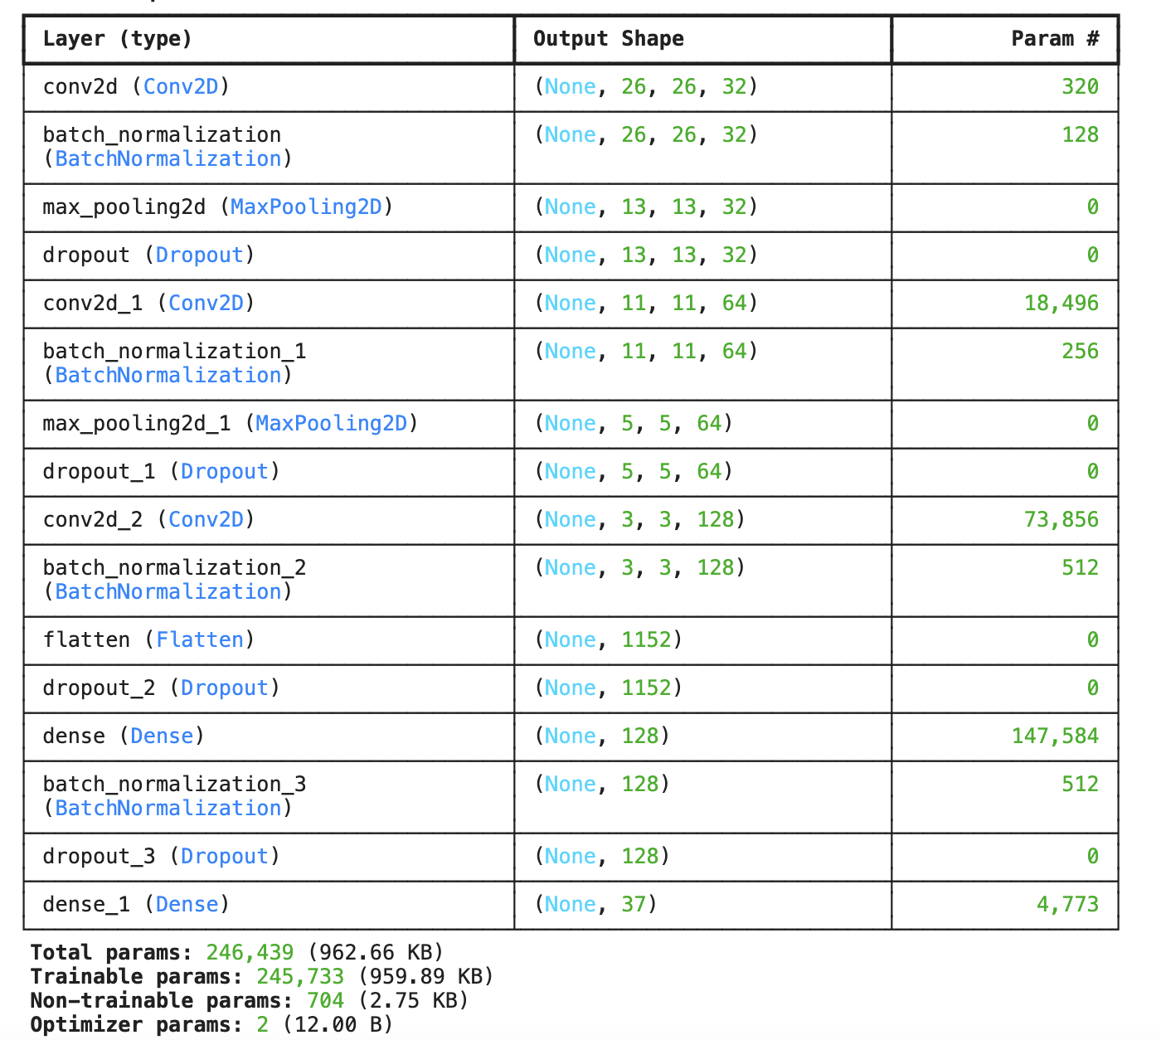
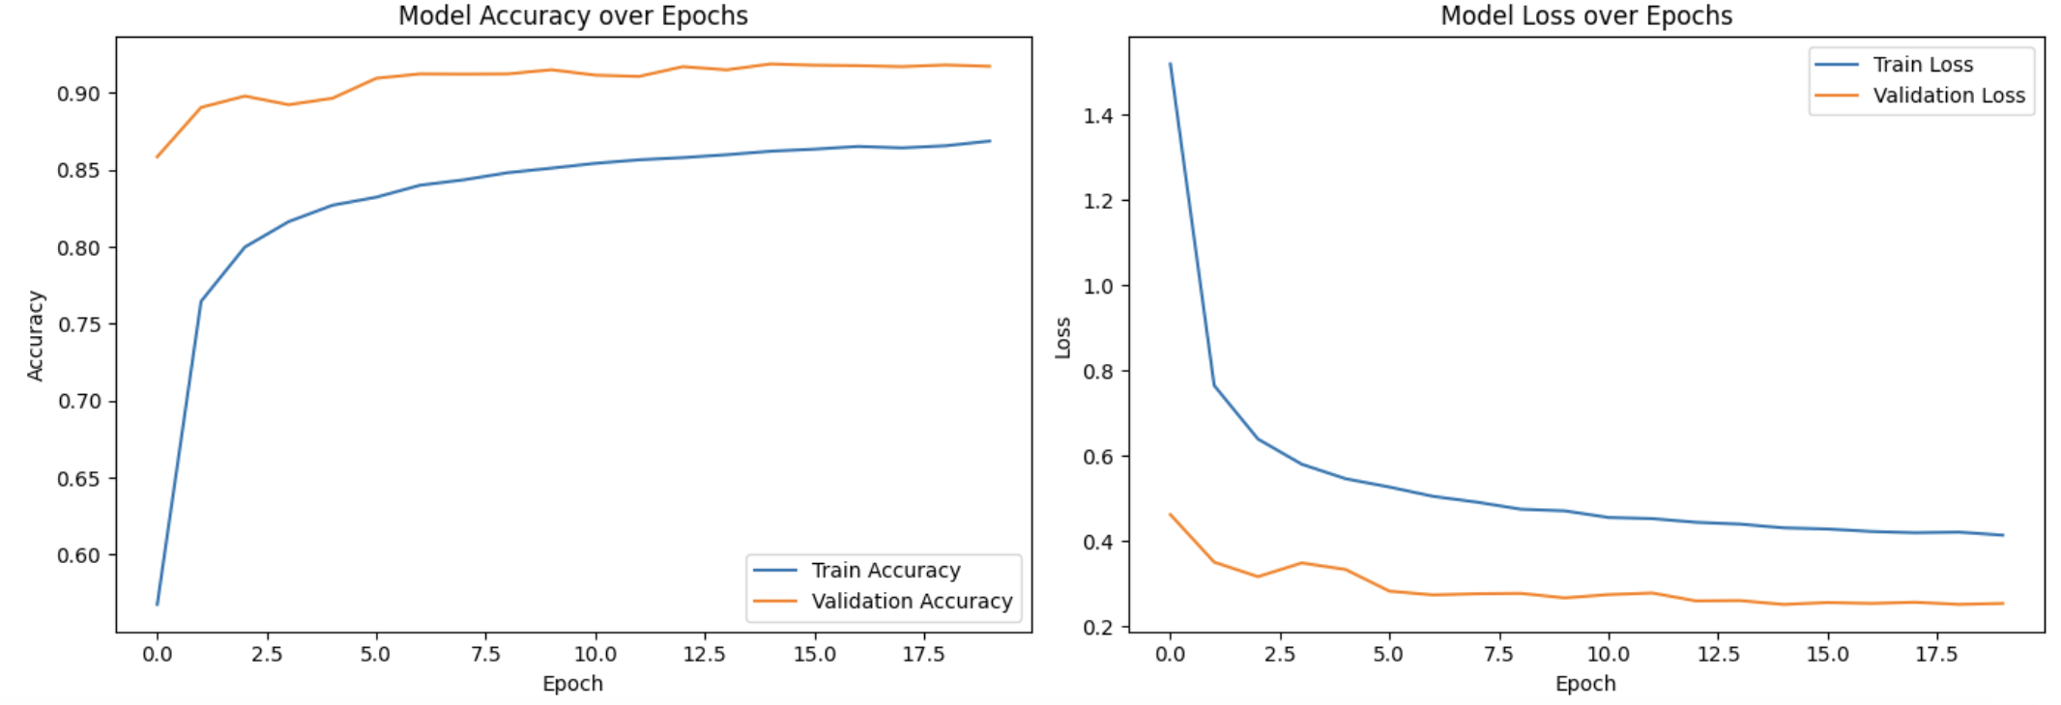
More complex model

Slide 41
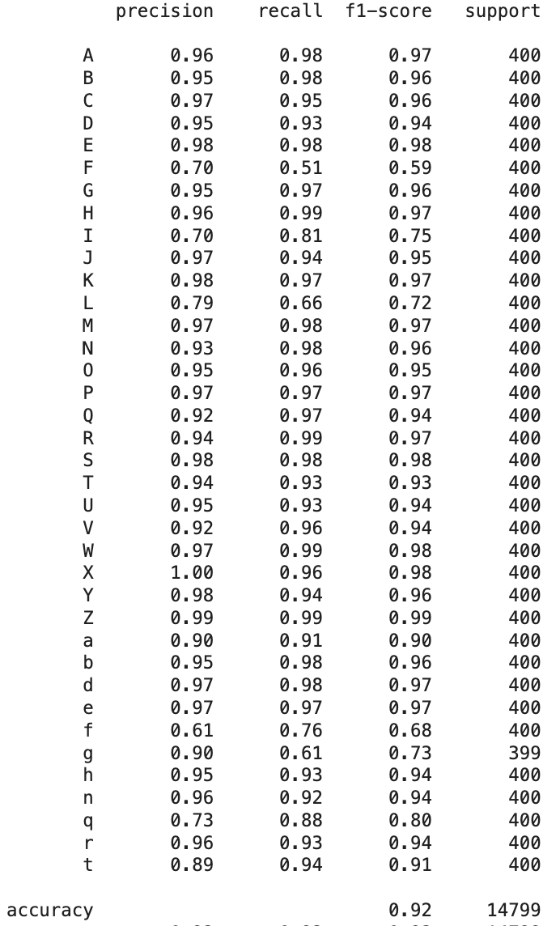
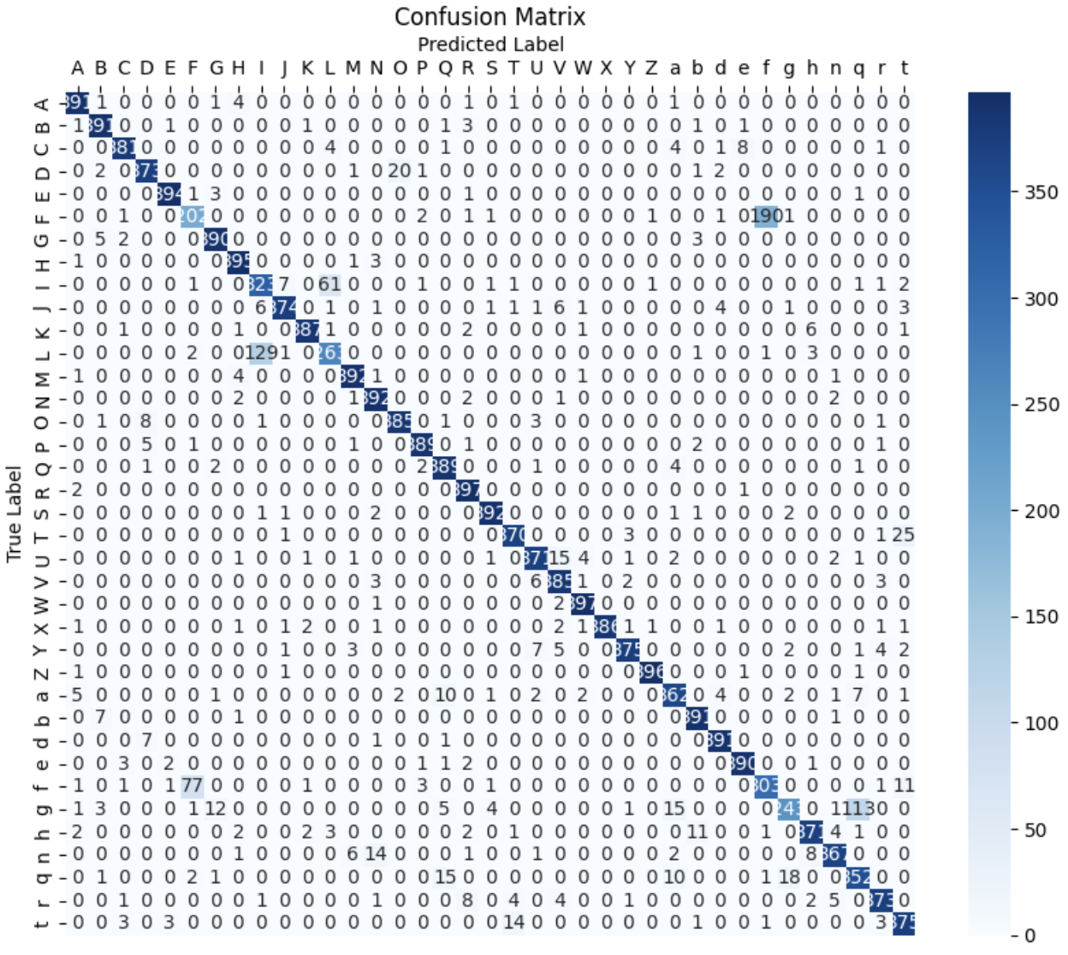
Putting all together

Slide 42
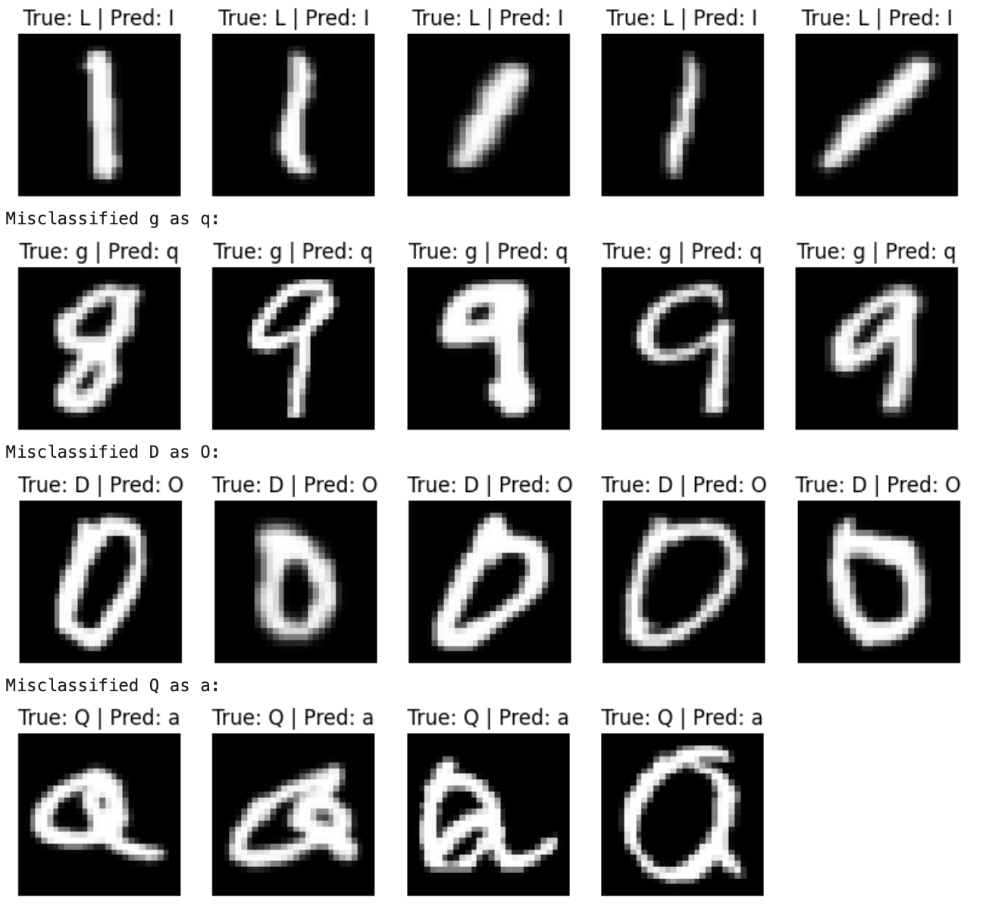
Remained misclassifications

Slide 43
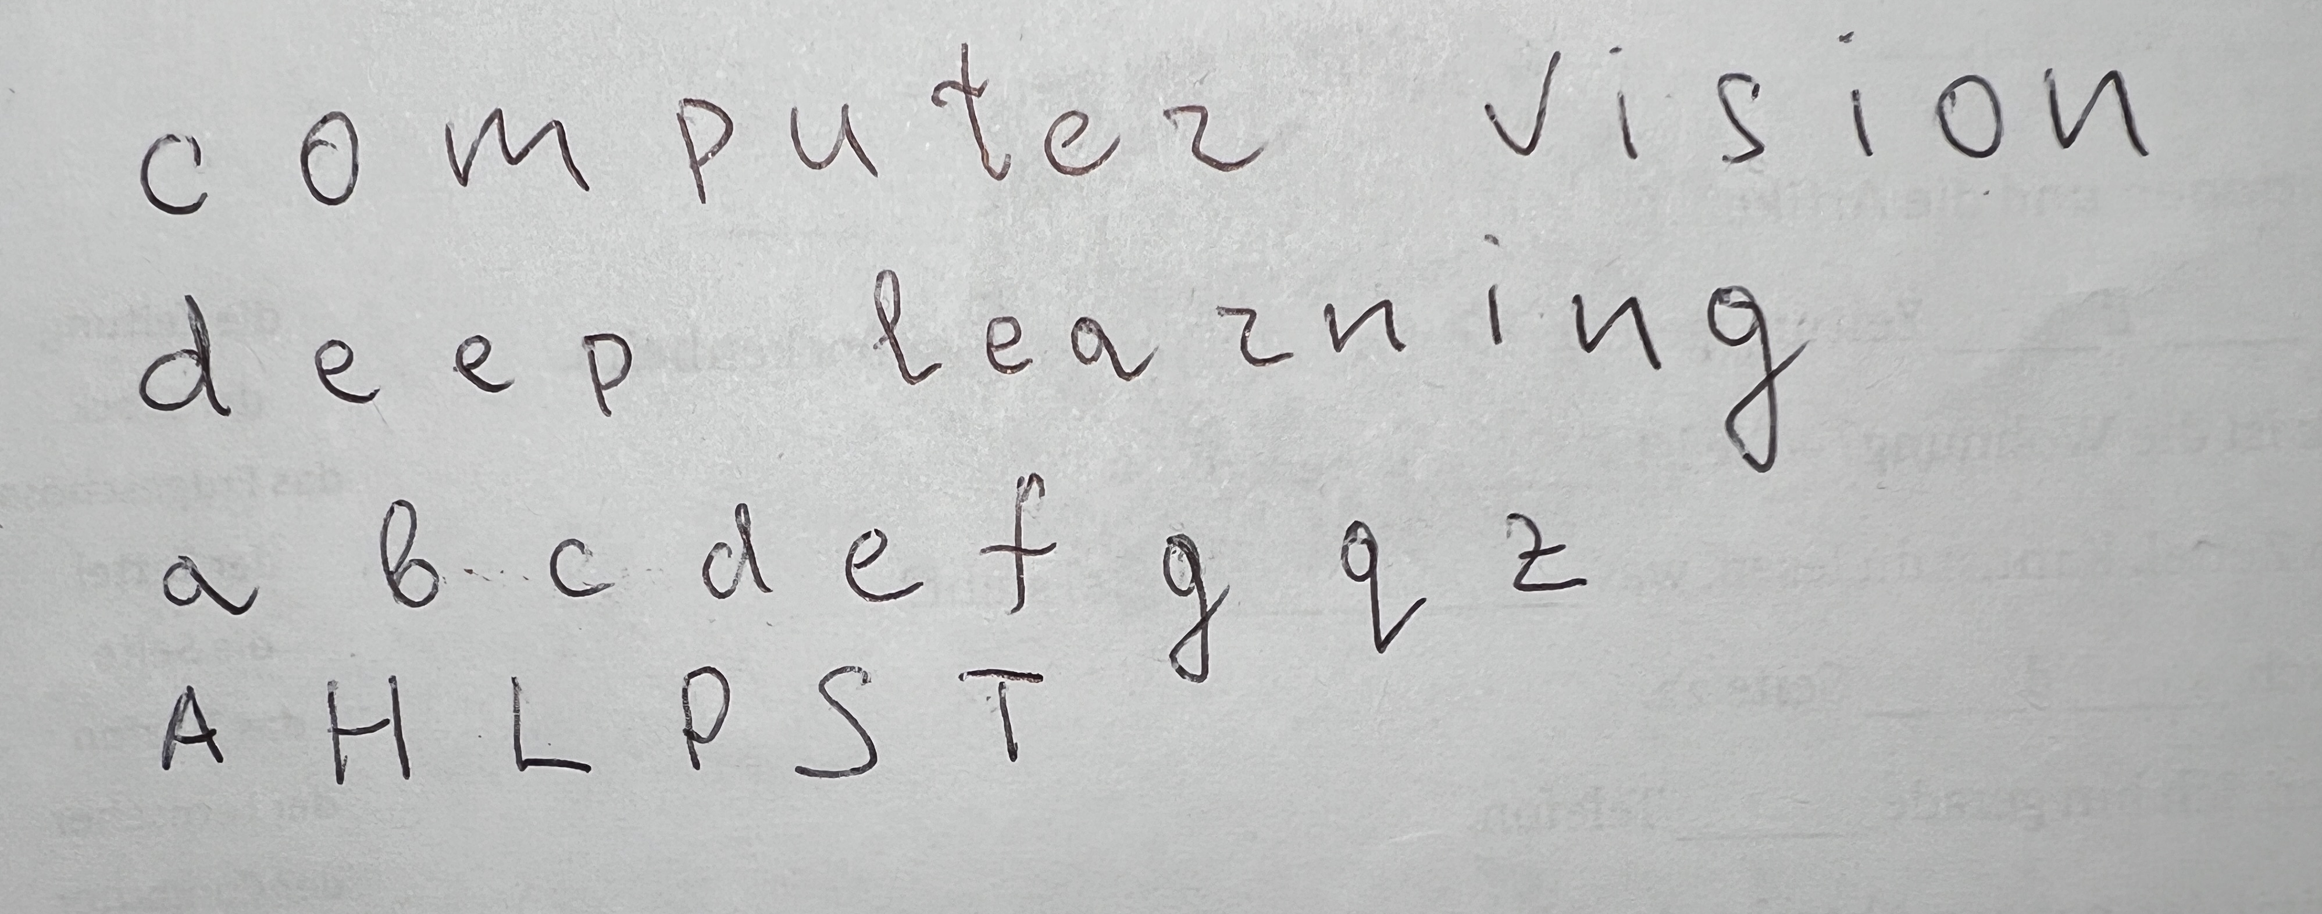
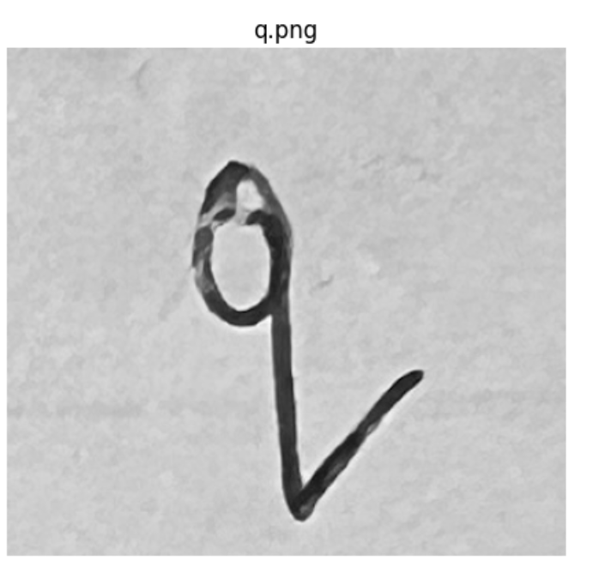
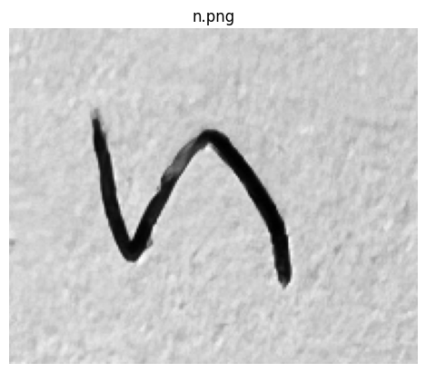
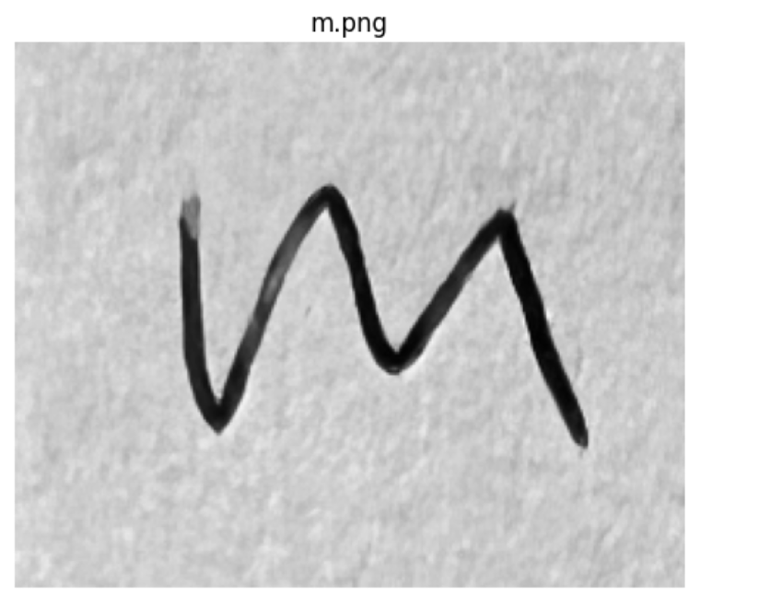
Recognition of own letters on paper

Slide 44
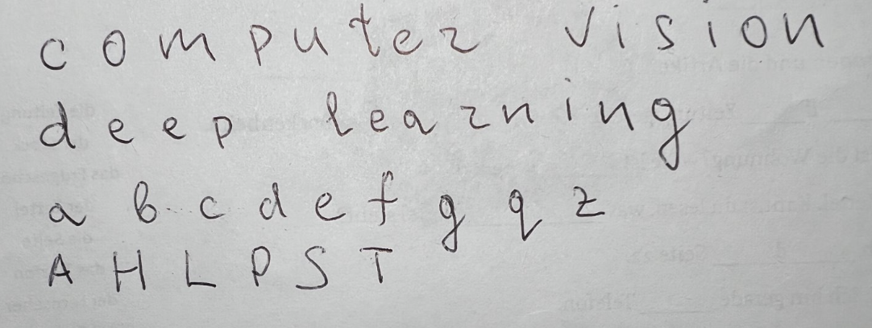
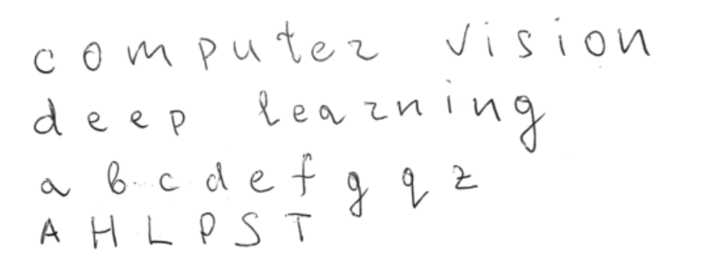
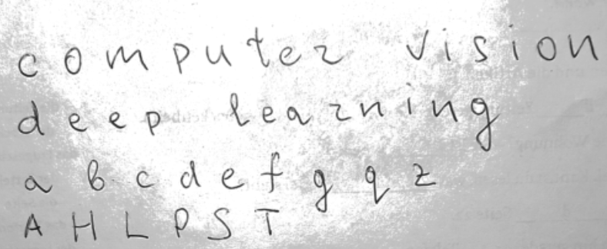
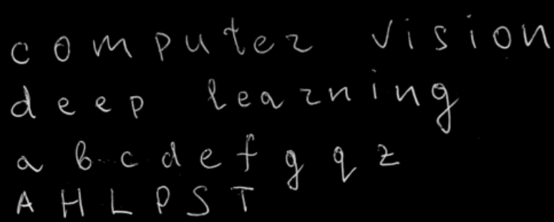
Preprocessing
1
3
2
4

Slide 45
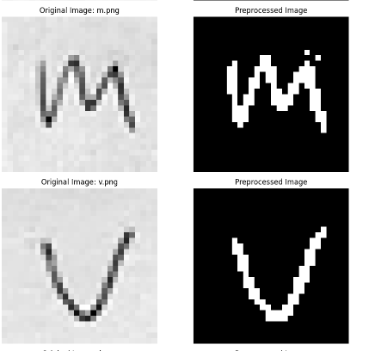
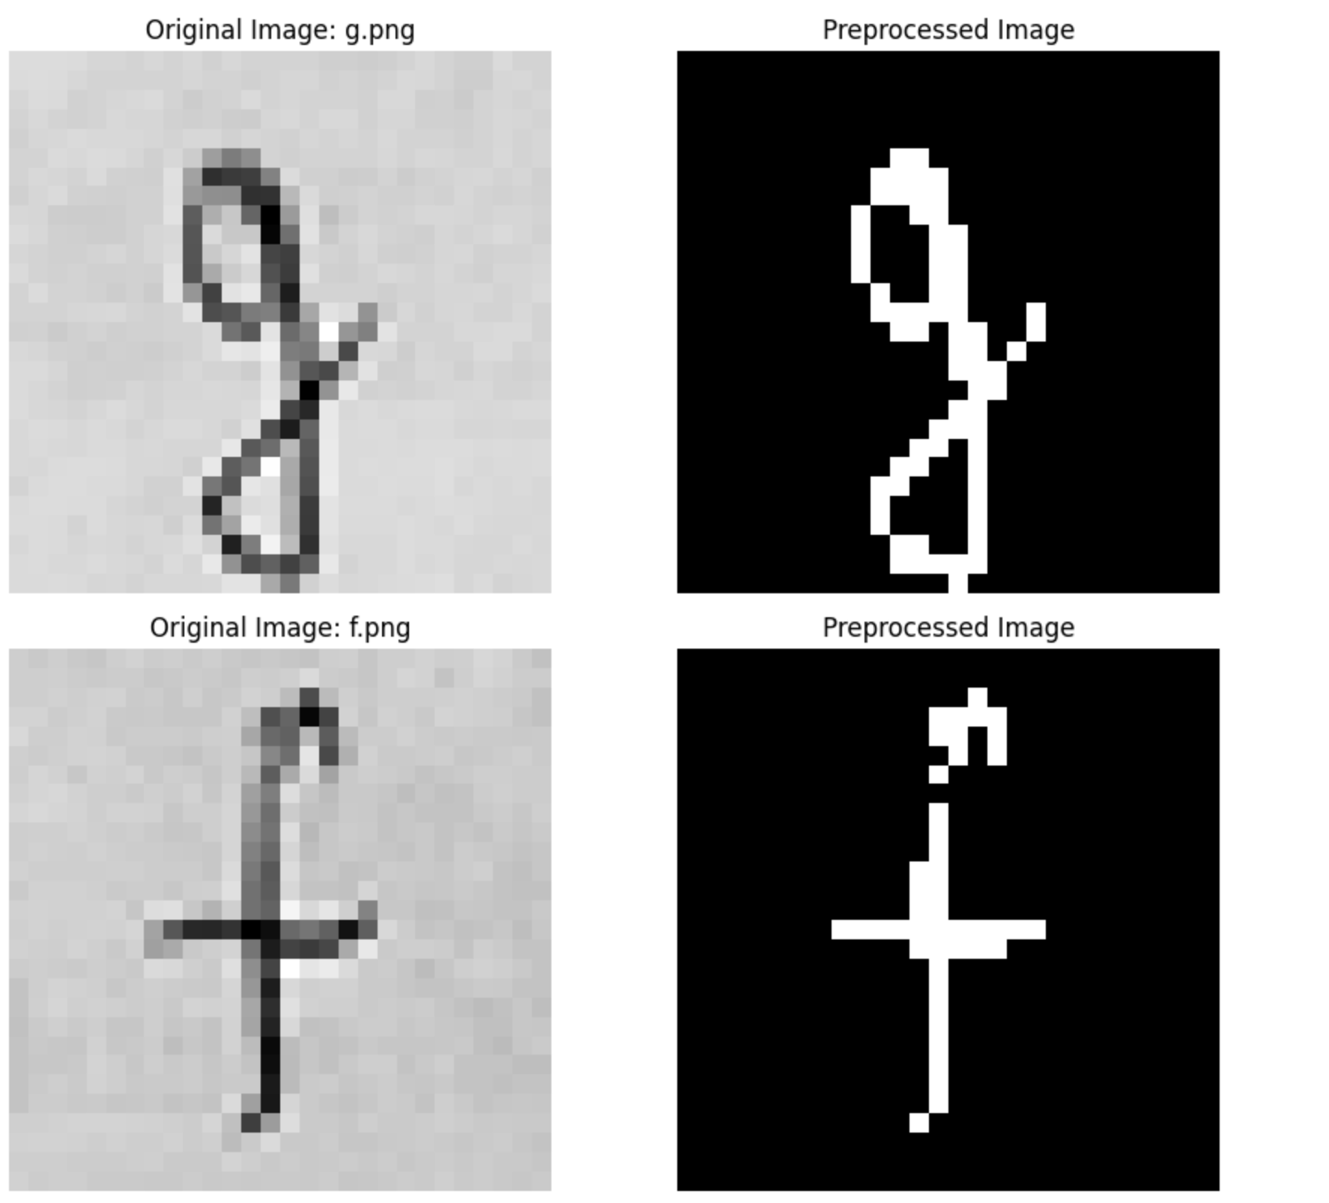
Letters on PAPER

Slide 46
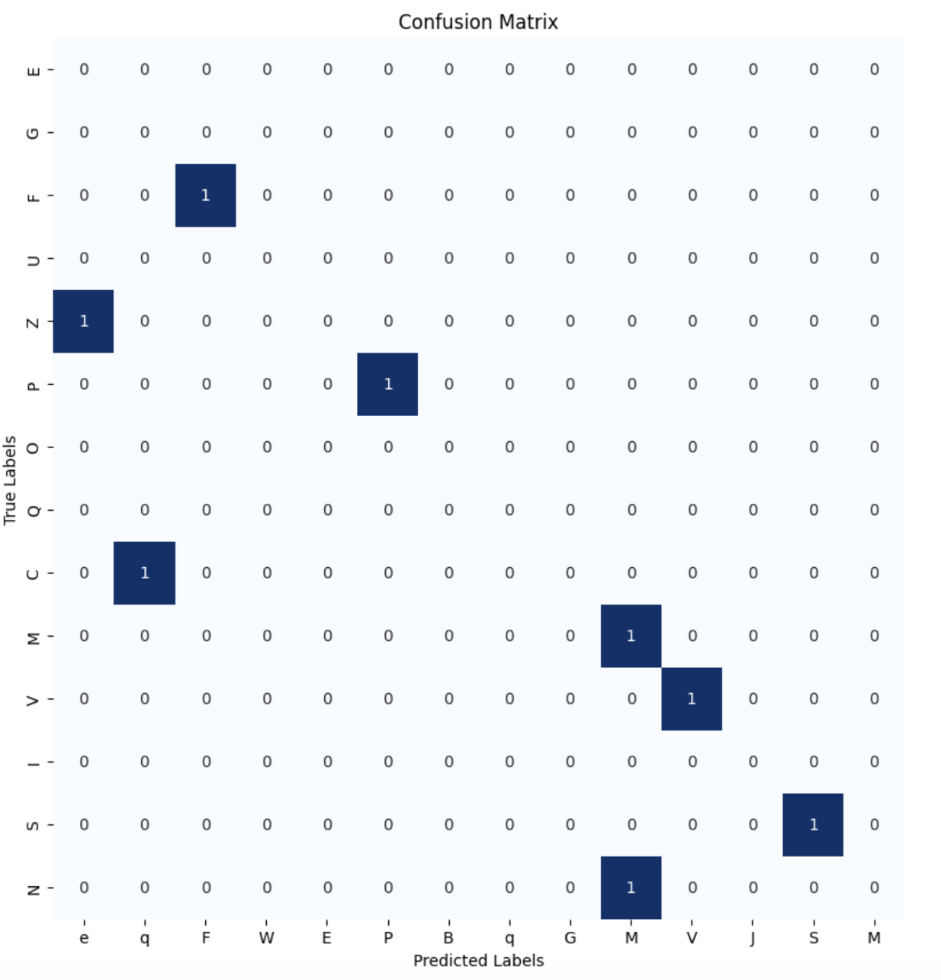
Letters on PAPER

Slide 47
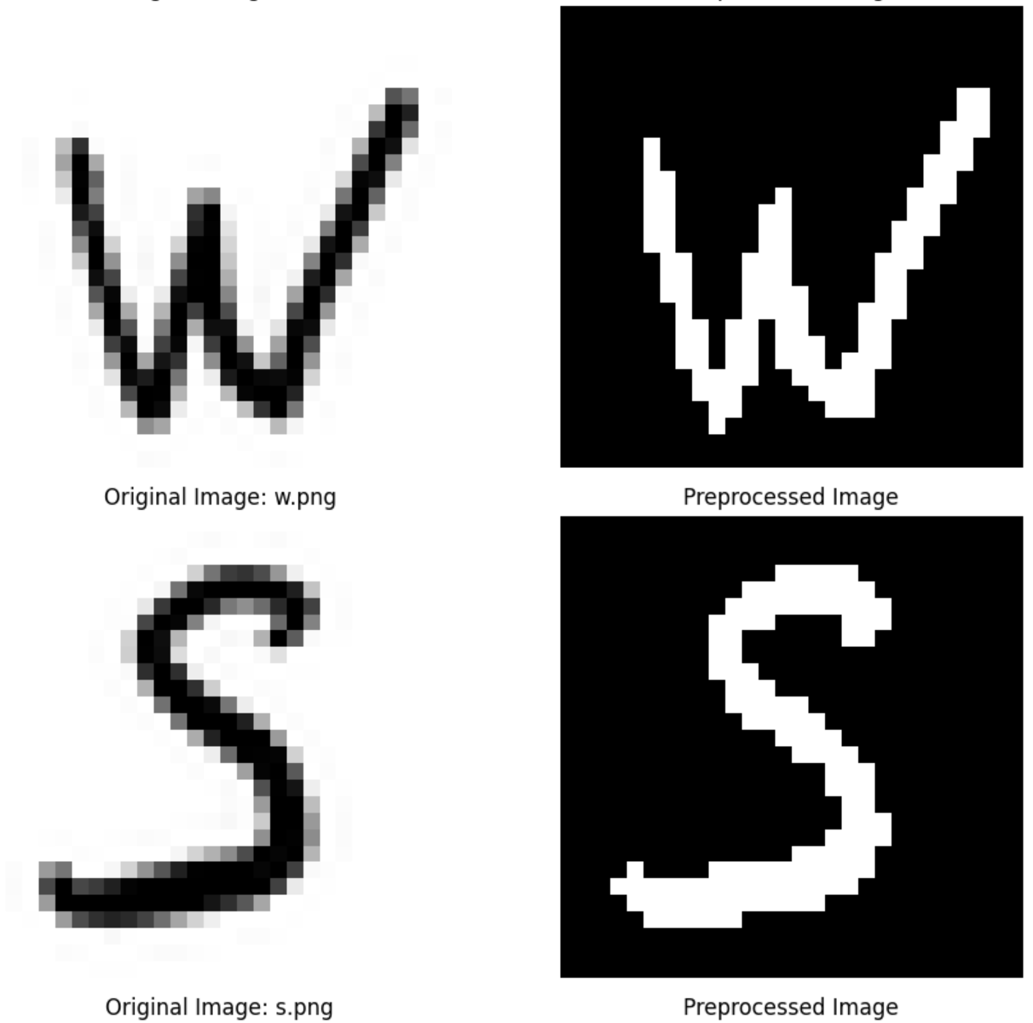


Recognition of own letters on iPad

Slide 48

Performance with the "best" model

Slide 49

Performance with simple model

Slide 50



Other symbols: Cyrillic, German, Smiles

Slide 51

Result of classifying other symbols

Slide 52
Object Detection & Translation
04.1

Slide 53
Pipeline
Load and Display the Input Image
Perform Selective Search for Letter Detection
Filter and Sort Detected Regions
Preprocess Detected Letter Regions for Classification
Classify Each Detected Letter
Combine Classified Letters into a Word
Translate!

Slide 54


Image

Slide 55

Detected regions

Slide 56

Classified "letters"

Slide 57


Objects detected in "world"

Slide 58

Classified "world"

Slide 59

Classified "WORLD"
!!!

Slide 60

Translation

Slide 61

Translation (behind the scene)

Slide 62
6
Future Work

Slide 63




Future Work
Further fine-tune the TrOCR model on domain-specific datasets to improve accuracy for particular types of calculations or handwriting styles.
Enhance the system to recognize and process more complex mathematical symbols and equations, expanding its capabilities beyond basic calculations.
Real-time OCR and translation for live video streams, enabling instant calculation and translation of handwritten text.
Update the pipeline to be able to recognize sentences not only words

